Slide 1

United States VS Canada
Who has the better Healthcare System?

Slide 2

The goal:
To identify which country has a better healthcare system overall
To reveal in what cases The United States is superior
To reveal in what cases Canada is superior
Finally, to theorize how the losing country could implement the others best parts.

Slide 3

The Data

Slide 4
OECD
We searched online for good data sources, and the best one we found was OECD.org
The Organisation for Economic Co-operation and Development (OECD) is an international organisation that works to build better policies for better lives. (from their website)
It is a trustworthy organization and had great datasets, so we chose them as our source.
Unfortunately, the latest data from both countries was 2015-16, so all of the information presented is from those two years

Slide 5
Now that we had identified our source, it was time to parse and clean the data.
We had to identify what mattered: we removed most crude (non standardized) data that we had standardized information on, and removed data that we considered irrelevant.

Slide 6
The Analysis

Slide 7
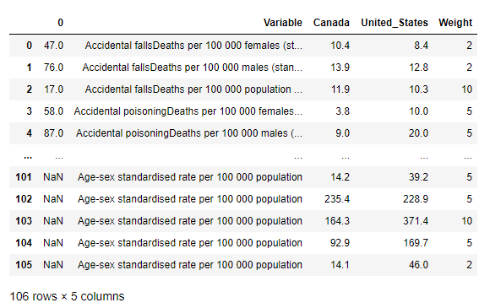
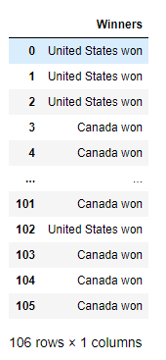
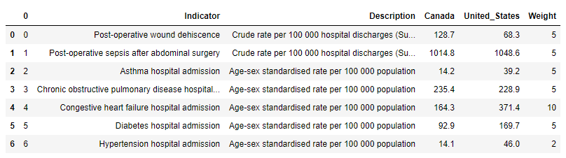
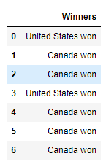
DataFrames
1)
2)
After the data was parsed and organized the two main dataframes for each “winner” category that was decided was made with pandas. The two dataframes were created based on different aspects of health/wellness and healthcare. The first was for determining death rates
of curable diseases and
the second was efficacy
of hospitals.

Slide 8
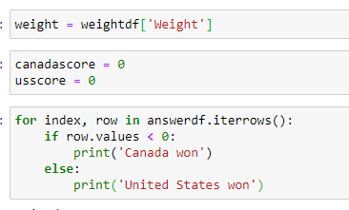
Code Explanation pt. 1
The python code consisted of two main parts: the first is as shown which was used on the previous dataframes in order to determine which country won in each aspect of the data that was gathered.

Slide 9
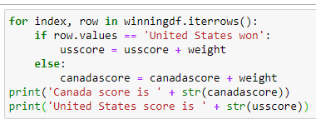
Code Explanation pt. 2
The second main piece of python code was used in correlation to a new dataframe that was made with the data showing which country won which category. From there this piece of code was used to pull the weight scores and add them up based on which country won for each corresponding category.

Slide 10




Overall Scores: Canada vs United States
After the data was parsed and the python code was executed the winner was determined to be none other than Canada!
Healthcare Key Indicators:
Healthcare Key Indicators:
Health Status:
Health Status:
Final Canada score: 489
Final United States score: 184

Slide 11

The United States of America

Slide 12
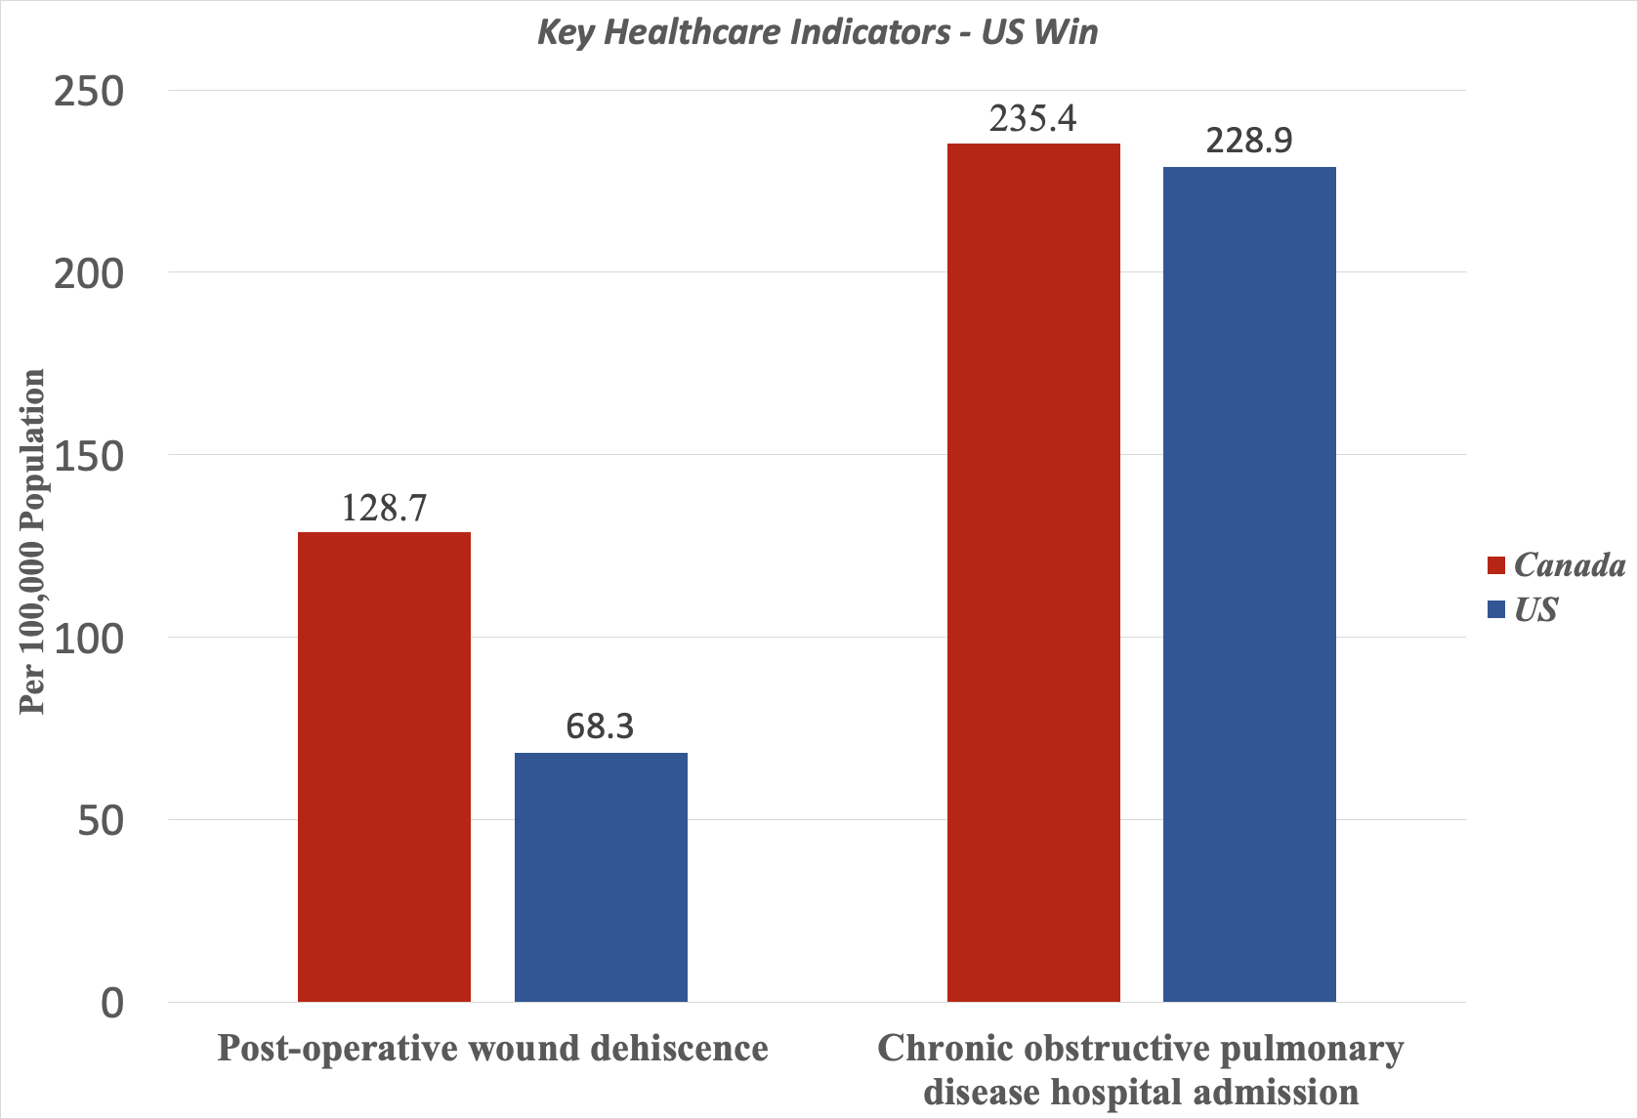

Slide 13
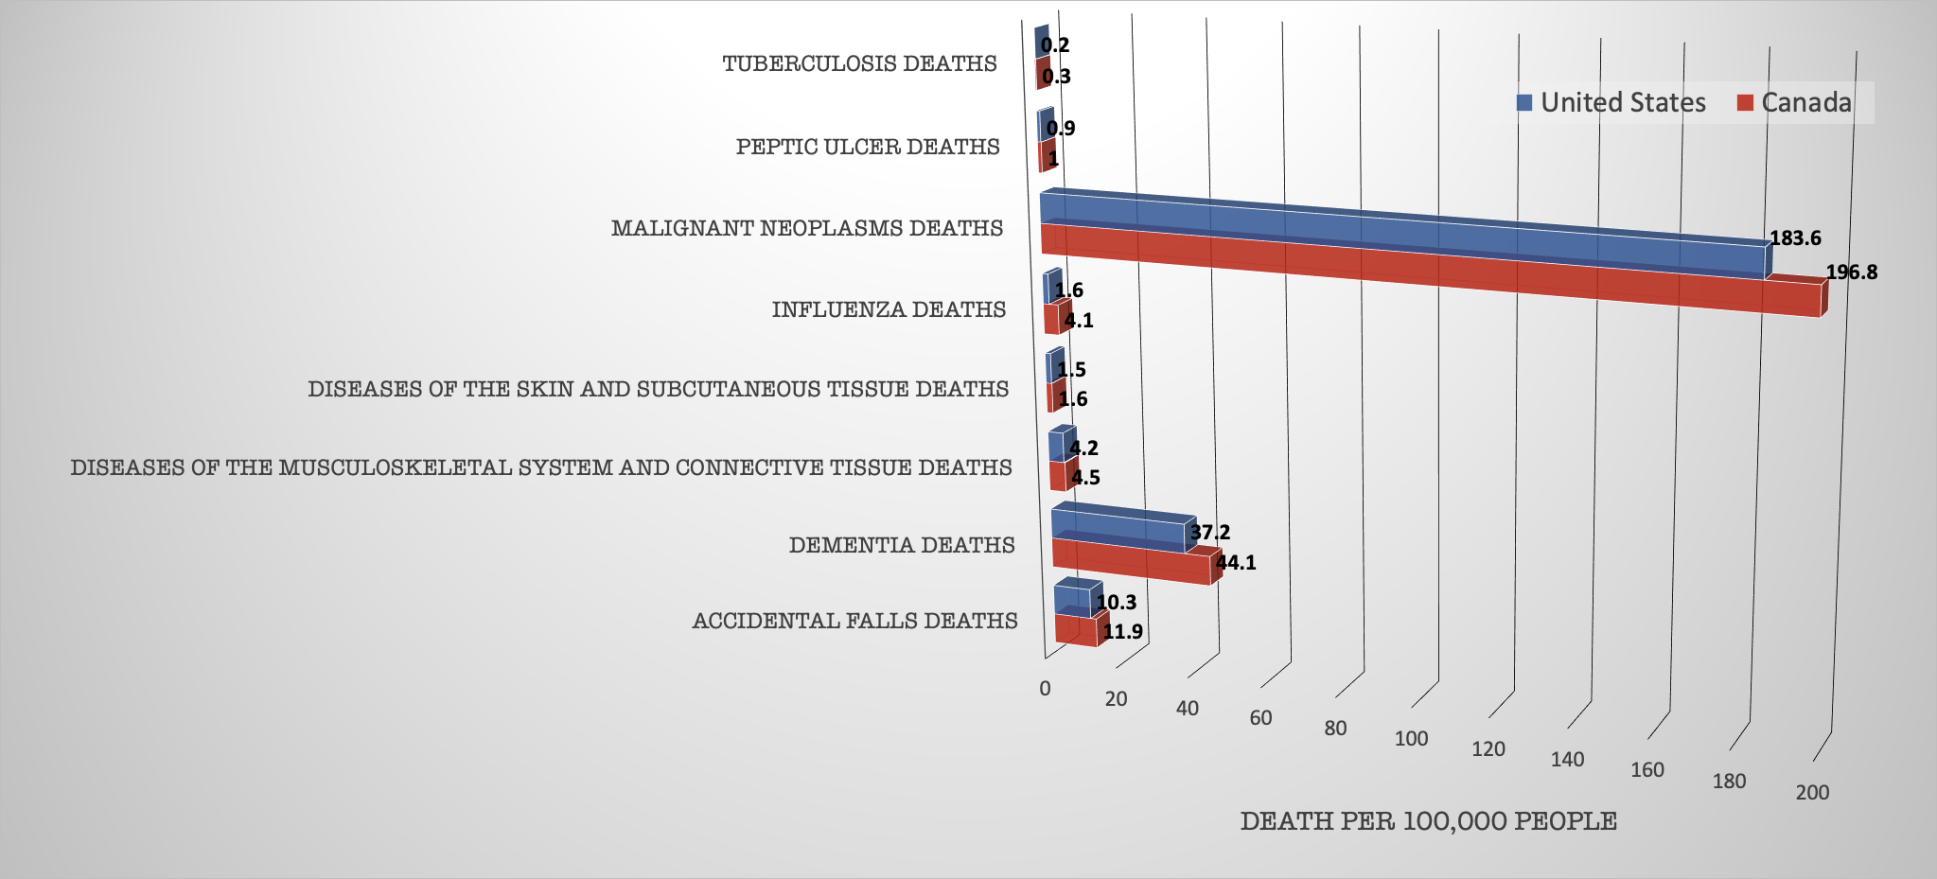
Health Status
Peter’s Slides

Slide 14

Canada

Slide 15
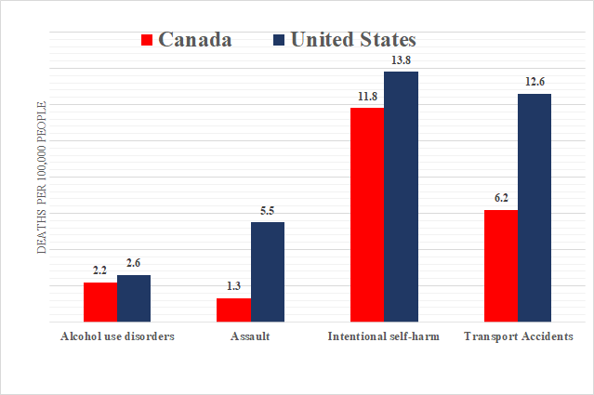

Slide 16
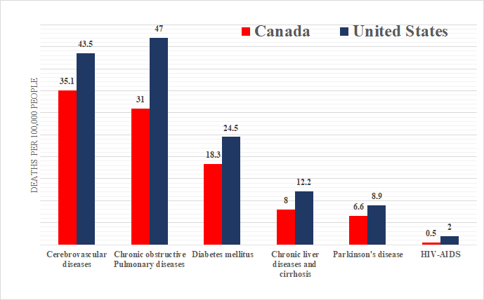

Slide 17
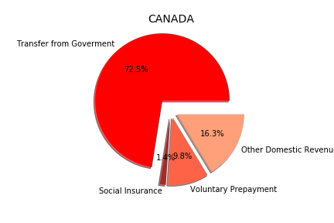
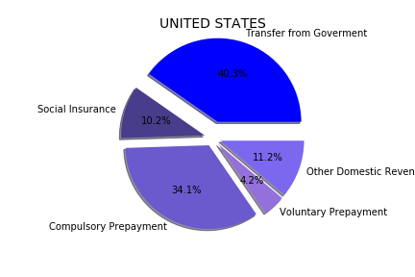
The total Revenue for each country’s Health System

Slide 18
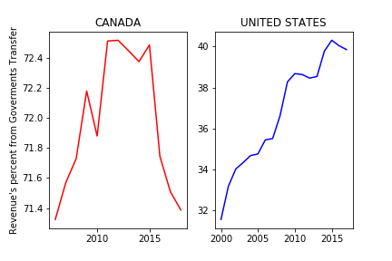

Slide 19

Learning from one another

Slide 20
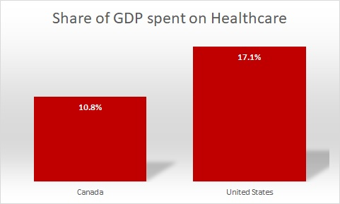
GDP (Gross Domestic Product)

Slide 21
The United States spends more money on pharmaceuticals

Slide 22
Example - Insulin
The United States - ~350$ a vial
Canada - ~35$ a vial
Cost of production - ~6$ a vial

Slide 23

“Single Payer System”

Slide 24
Canada’s System
Single payer
The Canadian Government pays for all essential healthcare using tax revenue
No need for private insurance
No need to not go to the hospital for any financial reason

Slide 25
“The most expensive part about going to the hospital in Canada is the parking bill”

Slide 26
The United States’ System
Multi-Payer System
Private Insurance, purchased by you or provided through employer
Individual pays a co-pay
Plans can cover everything, or next to nothing, well, or poorly

Slide 27
What can The States learn from Canada?
Canadians are united in their concept of who should get healthcare and how much it should cost.
It is not a political conversation.

Slide 28
A single payer system
It is my belief, based on the data we have gathered, that The United States should move slowly towards a single payer system.
Most economists agree it is simply the most efficient method of funding healthcare while also producing a higher quality of life.

Slide 29
We already have something similar
Medicare - A system designed to cover people over 65 years of age as they are likely to retire, and no longer have insurance be covered by their employer.
It is further improved by Medicare Advantage - a supplemental private option.

Slide 30
So, Canada won?
Yes, but we all have the opportunity in this moment to make it so both countries win from this analysis. By acknowledging our shortcomings and identifying ways to improve them, that in itself is a win for The United States.

Slide 31
Thank you!
Project Members
Colin Prince
Jerry Reyes
Peter Lu
Logan Contreras

